Slide 1
CSE495B (Natural Language Processing) Lecture 13
Working with Language Models: Reasoning & Prompting

Slide 2
Elements of Prompts
A prompt contains any of the following elements:
Instruction - a specific task or instruction the model should perform
Context – facts, external information, or additional context that can steer the model to better responses
Input Data - the input or question that we are interested in finding a response for
Output Indicator - the type or format of the output.
Classify the text into neutral, negative, or positive
Text: I think the food was okay.
Sentiment:

Slide 3
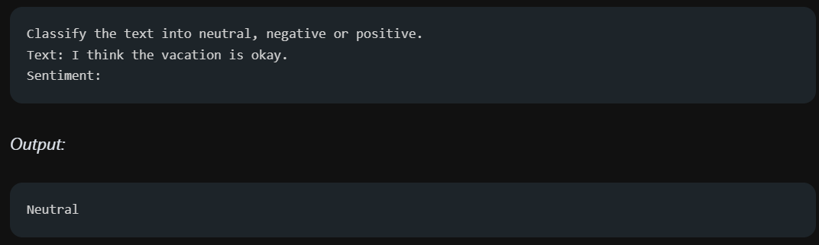
Zero-shot Prompting
Large-scale training makes large language models (LLMs) capable of performing some tasks in a "zero-shot" manner.
That the prompt used to interact with the model won't contain examples or demonstrations.
The zero-shot prompt directly instructs the model to perform a task without any additional examples.

Slide 4
Zero-shot Prompt
Proper instruction tuning improves zero-shot inferences
Instruction tuning is essentially the concept of fine-tuning models on datasets described via instructions.
Furthermore, RLHF (reinforcement learning from human feedback) has been adopted to scale instruction tuning wherein the model is aligned to better fit human preferences.
This recent development powers models like ChatGPT.

Slide 5
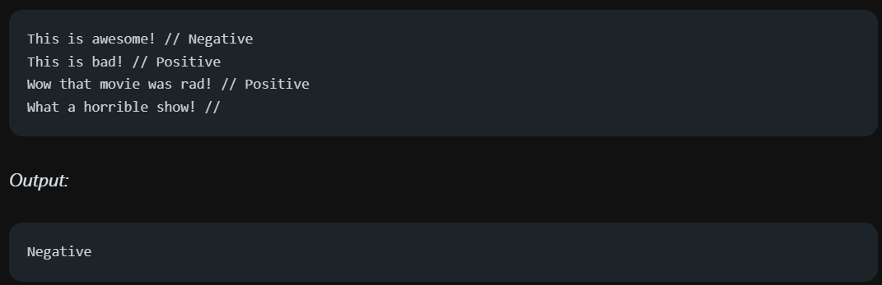
Few-shot Prompt
Large-language models still struggle on more complex tasks when using the zero-shot setting
Few-shot prompting can be used as a technique to enable in-context learning, where we provide demonstrations of the prompt to steer the model to better performance.
According to Touvron et al. 2023 few shot properties first appeared when models were scaled to a sufficient size (Kaplan et al., 2020).
Notes:
https://arxiv.org/pdf/2302.13971.pdf
https://arxiv.org/abs/2001.08361

Slide 6

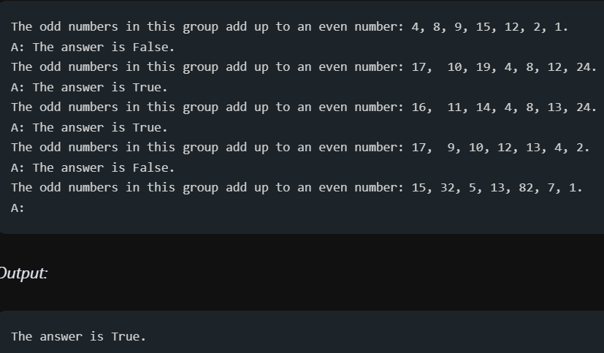
Limitations of Few-shot Prompt

Slide 7
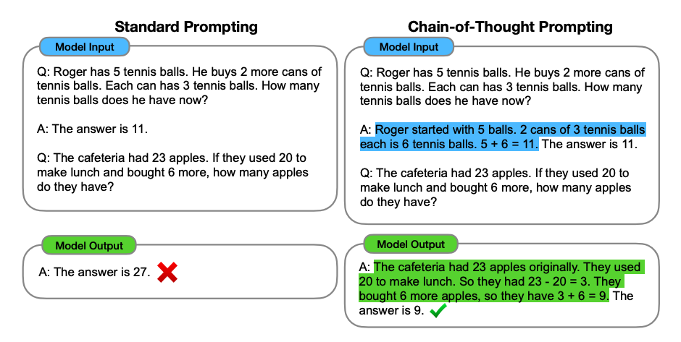
CoT Prompt

Slide 8
Chain of Thought Prompting
A chain of thought—a series of intermediate reasoning steps—significantly improves the ability of large language models to perform complex reasoning
Such reasoning abilities emerge naturally in sufficiently large language models
For solving a complicated reasoning task such as a multi-step math word problem
It is typical to decompose the problem into intermediate steps and solve each before giving the final answer:
“After Jane gives 2 flowers to her mom she has 10 . . . then after she gives 3 to her dad she will have 7 . . . so the answer is 7.”

Slide 9
Chain-of-Thought Properties
CoT allows models to decompose multi-step problems into intermediate steps, which means that additional computation can be allocated to problems that require more reasoning steps
Provides an interpretable window into the model’s behavior
How it might have arrived at a particular answer and providing opportunities to debug where the reasoning path went wrong (although fully characterizing a model’s computations that support an answer remains an open question).
Can be used for tasks such as math word problems, commonsense reasoning, and symbolic manipulation, and is potentially applicable (at least in principle) to any task humans can solve via language.
Can be readily elicited from sufficiently large off-the-shelf language models simply by including chain-of-thought examples within few-shot prompts.

Slide 10
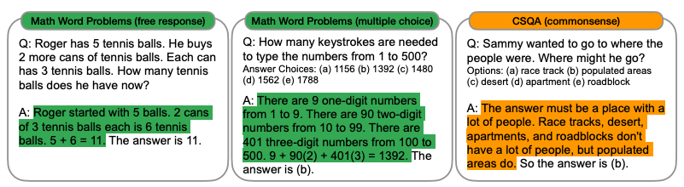
Chain-of-Thought Example

Slide 11
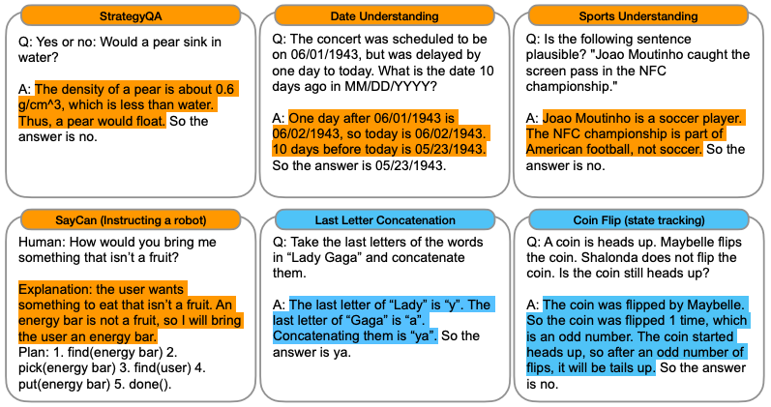
Chain-of-Thought Example

Slide 12
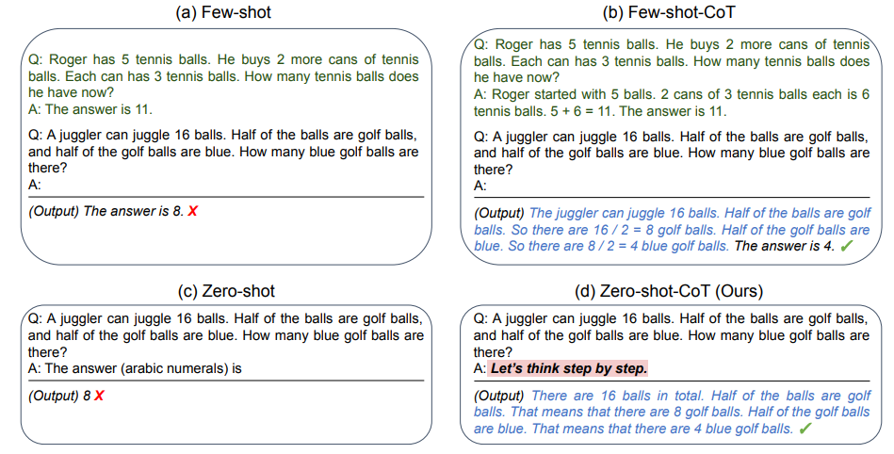
Zero Shot Chain-of-Thought
Zero-shot CoT adds a single prompt like “Let’s think step by step” after the test question
Since this prompting paradigm is task-agnostic and does not need input-output demonstrations, it is called Zero-Shot-CoT

Slide 13
Automatic Chain-of-Thought
CoT prompting has two major paradigms.
One leverages a simple prompt like “Let’s think step by step” to facilitate step-by-step thinking before answering a question.
The other uses a few manual demonstrations one by one, each composed of a question and a reasoning chain that leads to an answer.
The superior performance of the second paradigm hinges on hand-crafting task-specific demonstrations one by one.

Slide 14
Automatic Chain-of-Thought
It is possible to eliminate the manual efforts by leveraging LLMs with the “Let’s think step by step” prompt to generate reasoning chains for demonstrations one by one, i.e., let’s think not just step by step, but also one by one.
However, these generated chains often come with mistakes. To mitigate the effect of such mistakes, we find that diversity matters when automatically constructing demonstrations.
AutoCoT samples questions with diversity and generates reasoning chains to construct demonstrations.

Slide 15
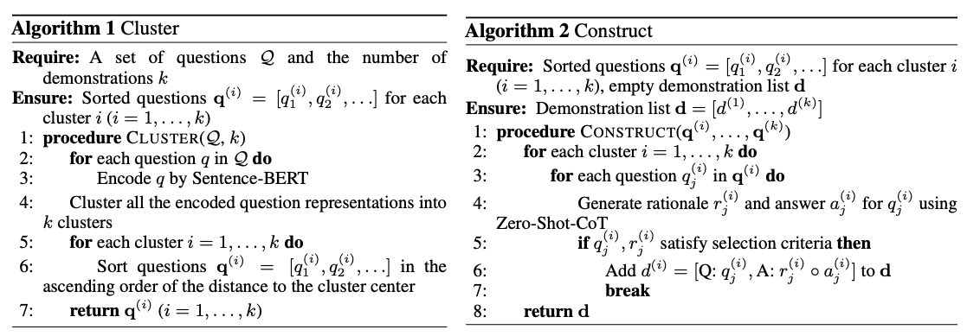
Automatic CoT

Slide 16
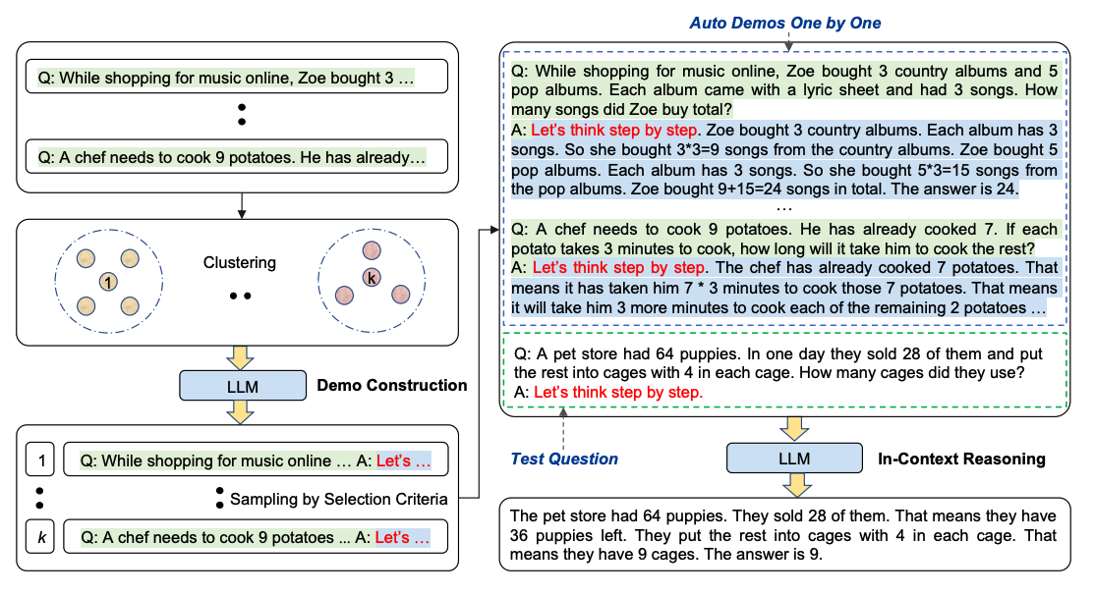
Automatic Chain-of-Thought

Slide 17
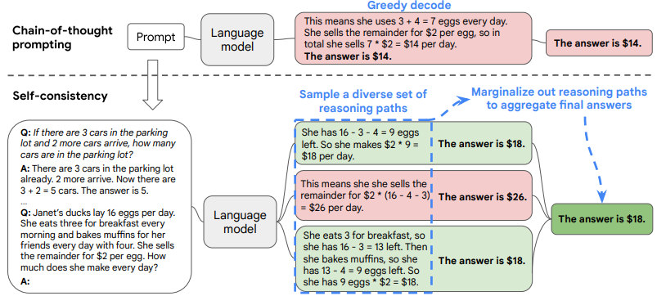
Ensemble prompting: Self Consistency

Slide 18
Self Consistency: CoT Reasoning
Prompt the language model with chain-of-thought prompting, then instead of greedily decoding the optimal reasoning path, “sample-and-marginalize” decoding procedure:
First sample from the language model’s decoder to generate a diverse set of reasoning paths;
each reasoning path might lead to a different final answer, determine the optimal answer by marginalizing out the sampled reasoning paths to find the most consistent answer in the final answer set.
Such an approach is analogous to the human experience that if multiple different ways of thinking lead to the same answer, one has greater confidence that the final answer is correct.
Compared to other decoding methods, self-consistency avoids the repetitiveness and local-optimality that plague greedy decoding, while mitigating the stochasticity of a single sampled generation.

Slide 19
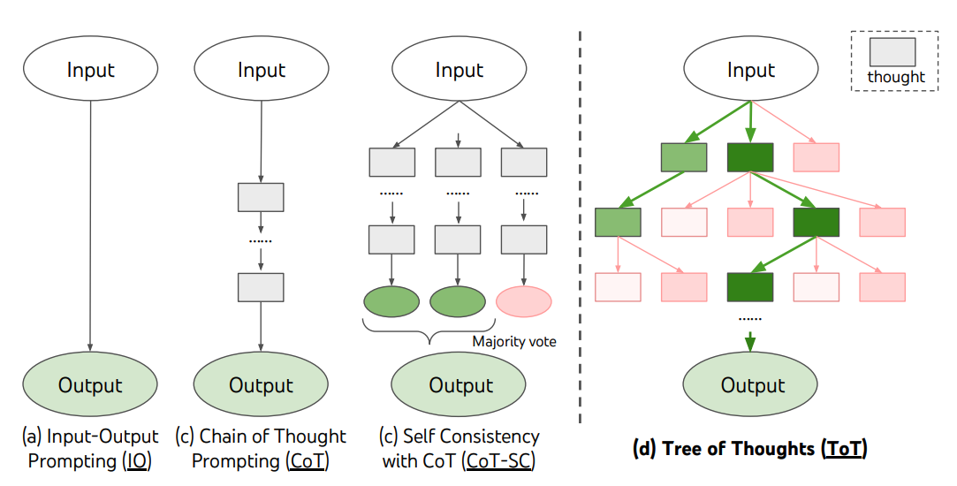
Tree-of-thought Prompt
ToT maintains a tree of thoughts, where thoughts represent coherent language sequences that serve as intermediate steps toward solving a problem.

Slide 20
Tree-of-thought Prompt
This approach enables an LM to self-evaluate the progress through intermediate thoughts made towards solving a problem through a deliberate reasoning process.

Slide 21
Tree-of-thought Prompt
The LM's ability to generate and evaluate thoughts is then combined with search algorithms (e.g., breadth-first search and depth-first search) to enable systematic exploration of thoughts with lookahead and backtracking.

Slide 22
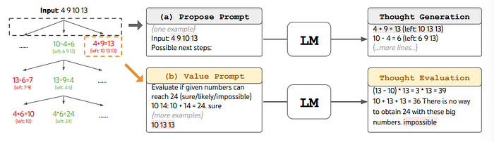
Tree-of-thoughts Prompt
Tree of Thought Prompting generates multiple lines of thought, resembling a decision tree, to explore different possibilities and ideas. Unlike traditional linear approaches, this technique allows the AI model to evaluate and pursue multiple paths simultaneously.

Slide 23
Generated Knowledge Prompt
Generated Knowledge Prompting (GKP) is a prompt engineering technique designed to enhance the performance of large language models (LLMs) by guiding them to generate relevant information before answering a question.
This approach helps in producing more accurate, contextually grounded, and reliable responses.
GKP involves a two-step process:
Knowledge Generation: The LLM is first prompted to produce background information, facts, or context related to the query
Answer Generation: The model then uses this generated knowledge to formulate a final response to the original question
This method is similar to Chain-of-Thought prompting, where the model is encouraged to reason through intermediate steps.
However, GKP focuses on generating factual knowledge rather than just reasoning paths .

Slide 24
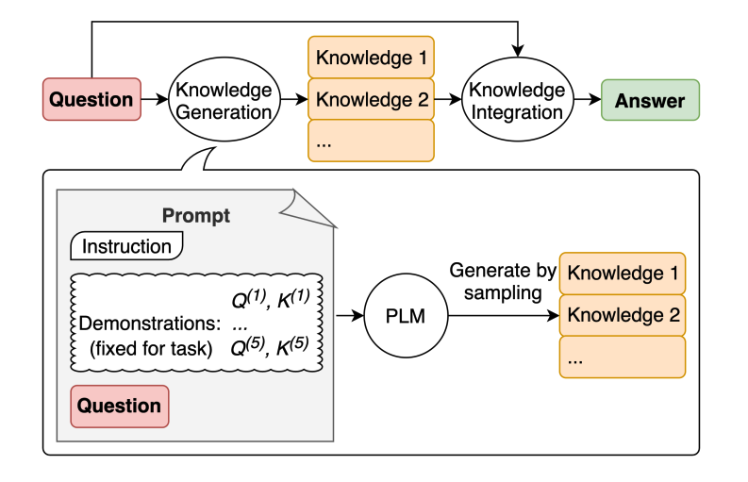
Generated Knowledge Prompt

Slide 25
Directional Stimulus Prompting
Directional Stimulus Prompting (DSP) is an advanced prompt engineering technique designed to guide large language models (LLMs), such as GPT-4 or PaLM, Gemini toward producing specific, context-sensitive outputs without altering the model's internal parameters.
DSP employs a two-model framework:
Policy Model: A small, tunable language model (e.g., T5) trained to generate a "directional stimulus"—a hint or cue tailored to the input.
Target LLM: A larger, often black-box model that receives the directional stimulus alongside the original input to produce the desired output.
This approach allows for precise control over the LLM's responses, enhancing accuracy and relevance, especially in tasks like summarization or question answering.

Slide 26
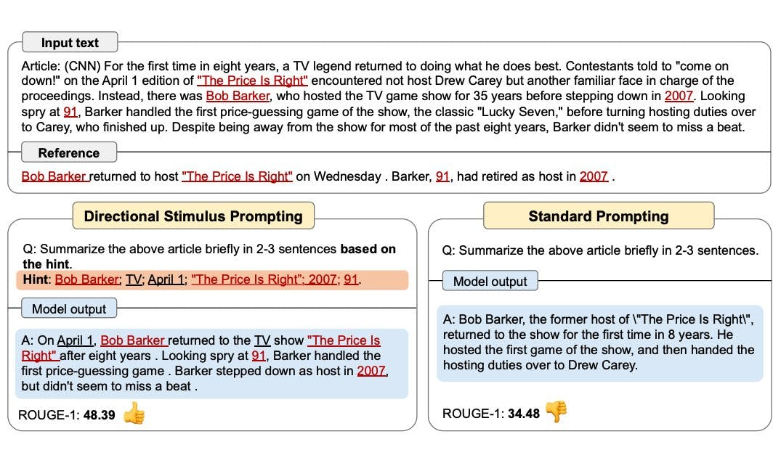
Directional Stimulus Prompting

Slide 27
ReAct Prompting
ReAct prompting—short for Reasoning and Acting—is an advanced prompt engineering technique that enables large language models (LLMs) to solve complex tasks by interleaving logical reasoning with actionable steps.
This approach enhances the model's ability to handle multi-step problems, interact with external tools, and produce more accurate, transparent, and grounded responses.
ReAct prompting guides LLMs to alternate between:
Thought: The model's internal reasoning about the problem.
Action: An operation the model performs, such as querying a database, searching the web, or invoking a function.
Observation: The result or feedback from the action taken.
This cycle continues until the model arrives at a final answer.

Slide 28
ReAct Prompting
By structuring prompts in this way, ReAct enables LLMs to:
Plan and adjust actions dynamically
Interact with external environments or tools
Incorporate new information into their reasoning process
This methodology is particularly effective for tasks that require both deep reasoning and real-time information retrieval.

Slide 29
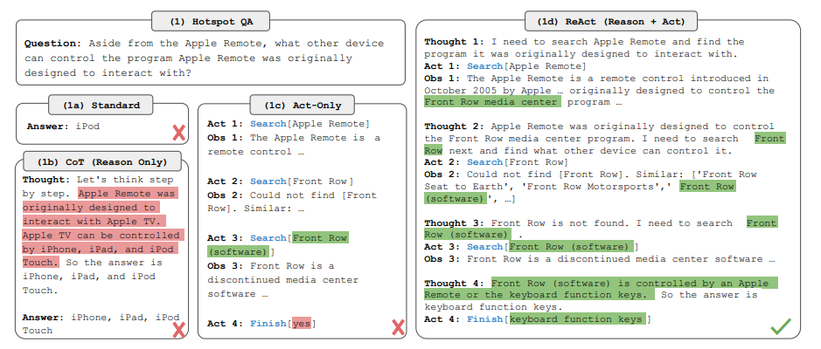
ReAct Prompting

Slide 30
What is RAG?
RAG complements the existing internal knowledge of the LLMs with new knowledge
RAG stands for:
Retrieval: Search for relevant data
Augmented: Add the data as context to the prompt
Generation: Use the augmented prompt with an LLM for generation Any LLM is bound to understand the data it was trained on, sometimes called parameterized knowledge.

Slide 31
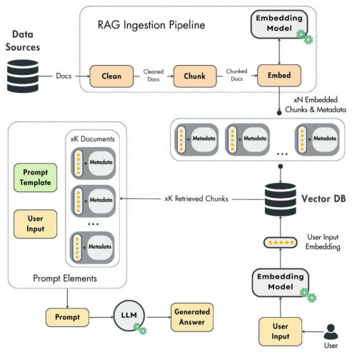
RAG Pipelines

Slide 32
Ingestion Pipeline
Gathers all the necessary data from sources such as DBs, APIs, or web pages
This module data source dependent
It can be as easy as querying data warehouse or as complex as crawling Wikipedia
A cleaning layer removes unwanted characters from the extracted data
A normalizing step
The chunking module splits the cleaned documents into smaller ones
Chunking is required to separate specific regions that are semantically related
For example, when chunking a book’s chapter, the most optimal way is to group similar paragraphs into the same section or chunk
The goal is to use the essential data during the retrieval time
The chunks are embedded and then stored in a vector database
Later module takes the embedded chunks along with a metadata document
The metadata contains essential information such as the embedded content, the URL to the source of the chunk, and when the content was published on the web
The embedding is used as an index to query similar chunks, while the metadata is used to access the information added to augment the prompt

Slide 33
Retrieval Pipeline
The retrieval components take the user’s input (text, image, audio, etc.), embed it, and query the vector DB for similar vectors to the user’s input
The primary function of the retrieval step is to project the user’s input into the same vector space as the embeddings used as an index in the vector DB
Find the top K similar entries by comparing the embeddings from the vector storage with the user’s input vector.
These entries then serve as content to augment the prompt that is passed to the LLM to generate the answer.
We must use a distance metric to compare two vectors, such as the Euclidean or Manhattan distance. But the most popular one is the cosine distance
Most of the time, the cosine distance works well in non-linear complex vector spaces. However, it is essential to notice that choosing the proper distance between two vectors depends on data and the embedding model.
One critical factor to highlight is that the user’s input and embeddings must be in the same vector space.

Slide 34
Generation Pipeline
The last step of the RAG system is to take the user’s input, retrieve data, pass it to an LLM, and generate a valuable answer
The final prompt results from a system and prompt template populated with the user’s query and retrieved context
You might have a single prompt template or multiple prompt templates, depending on your application. Usually, all the prompt engineering is done at the prompt template level.

Slide 35
Vector DB
Vector DBs are specialized DBs designed to efficiently store, index, and retrieve vector embeddings.
Traditional scalar-based DBs struggle with the complexity of vector data, making vector DBs crucial for tasks like real-time semantic search.
While standalone vector indices like FAISS are effective for similarity search, they lack vector DBs’ comprehensive data management capabilities. Vector DBs support CRUD operations, metadata filtering, scalability, real-time updates, backups, ecosystem integration, and robust data security, making them more suited for production environments than standalone indices.

Slide 36
Traditional DB vs Vector DB
Vector DBs are different than usual DBs.
Instead of perfect matches, we look for the closest neighbors of the query vector
A vector DB uses approximate nearest neighbor (ANN) algorithms to find these close neighbors.
While ANN algorithms don’t return the top matches for a given search, standard nearest neighbor algorithms are too slow to work in practice.
Also, it is shown empirically that using only approximations of the top matches for a given input query works well enough
Thus, the trade-off between accuracy and latency ultimately favors ANN algorithms.

